Slide 1
Rapid Object Detection Using a Boosted
Cascade of Simple Features
(V-J架构人脸检测)
Huang, Yibin(黄昳彬)

Slide 2
Table of Content（目录）
Structure
总体架构
Extremely brief introduction of Haar Features
(黑盒介绍haar特征)
Learning Classification Functions
学习分类方程
The Attentional Cascade
优秀的级联设计

Slide 3
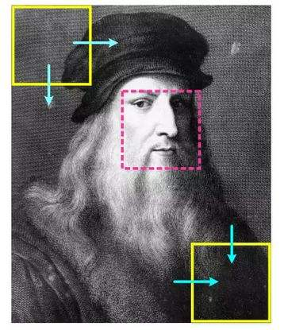

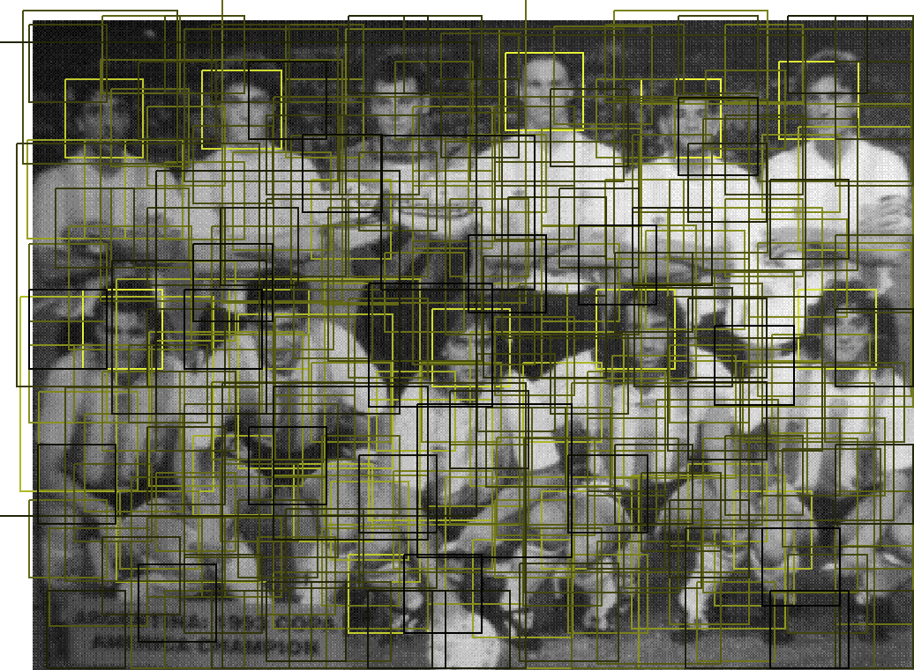
Sliding window detector
Feature extraction
feature
ML
0/1

Slide 4
Haar Feature (not machine learning content)
Feature Extraction
Algorithm
Haar-feature
24*24
Over 180000 dimensions
Other features: HOG, SIFT, SURF………

Slide 5



Learning Classification Functions
j: the index of haar feature
h: a weak classifier
:+1 or -1 to determine which side is the face
In practice no single feature can perform the classification
task with low error. Features which are selected in early
rounds of the boosting process had error rates between 0.1
and 0.3. Features selected in later rounds, as the task becomes
more difficult, yield error rates between 0.4 and 0.5.

Slide 6
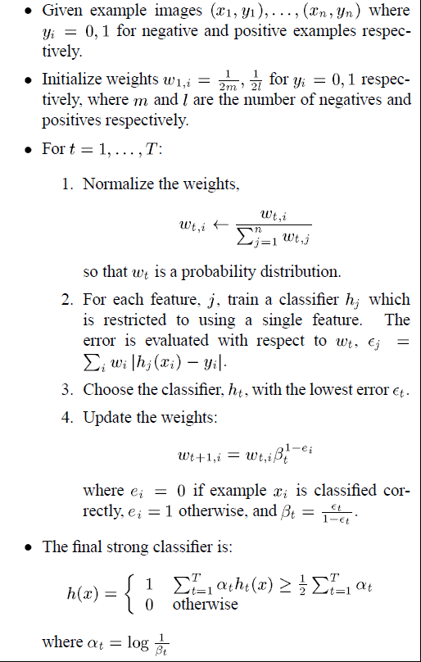
Adaboost for classifier
Initial experiments demonstrated that a frontal face classifier constructed from 200 features yields a detection rate of 95% with a false positive rate of 1 in
14084.

Slide 7
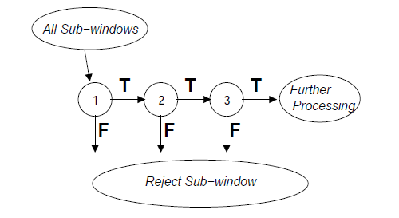
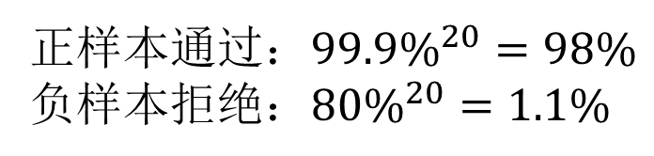
Attentional Cascade
Each stage is trained by adding features until the
target detection and false positives rates are met
( these rates are determined by testing the detector on a validation set).
正样本通过：${99.9\%}^{20}=98\%$
负样本拒绝：${80\%}^{20}=1.1\%$

Slide 8
Paper result
38 cascade layer The number of features in the first five layers of the detector
is 1, 10, 25, 25 and 50 features respectively.
The total number of features in all layers is 6061.
The approach was used to construct a face detection
system which is approximately 15 faster than any
previous approach.

Slide 9
